Slide 1
PAIRS OF STRAIGHT LINES
BAIBHAV DHITAL

Slide 2
TABLE OF CONTENTS
01
02
03
04
GENERAL EQUATION OF SECOND DEGREE
HOMOGENOUS EQUATION
ANGLE BETWEEN THE LINE PAIR
BISECTORS OF ANGLE BETWEEN PAIR OF LINES
05
CONDITION THAT THE GENERAL EQUATION OF SECOND DEGREE MAY REPRESENT A LINE PAIR

Slide 3
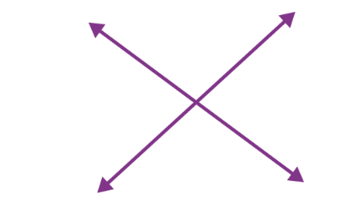
INTRODUTORY APPROACH
An introductory approach to understanding pairs of lines in geometry involves exploring the various relationships and properties that lines can have when they intersect or are parallel or perpendicular to each other. In this context, we will study and understand the different properties of pairs of lines.

Slide 4
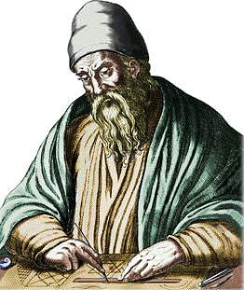
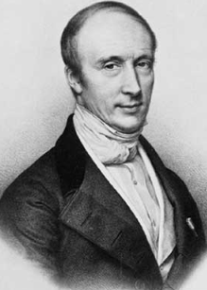
HISTORICAL APPROACH
1. Ancient Greece (circa 300 BCE):
Euclidean geometry by Euclid establishes the foundation for geometry.
2. 17th Century:
René Descartes introduces Cartesian coordinate system, allowing for algebraic representation of geometric figures.
4. 19th Century:
Augustin-Louis Cauchy and other mathematicians further develop analytical geometry theories and theorems, focusing on angles, intersections, and lines.
5. Modern Developments:
Introduction of vectors and vector spaces in the 20th century.
6. Application:
Analytical geometry is widely applied in physics, engineering, computer graphics, and various scientific and technical fields for precise geometric problem-solving.

Slide 5
01
GENERAL EQUATION OF SECOND DEGREE
CONCEPTUAL APPROACH

Slide 6
GENERAL EQUATION OF SECOND DEGREE
Let
and,
A₁x + B₁y + C₁ = 0 ……………. (i)
A₂x + B₂y + C₂ = 0 ……………..(ii)
represent equation of straight lines. Combining (i) and (ii)
(A₁x + B₁y + C₁) (A₂x + B₂y + C₂) = 0 ……….….(iii)
When we expand equation (iii)
ax₂ + 2hxy + by₂ + 2gx +2fy + c = 0

Slide 7
02
HOMOGENOUS EQUATION

Slide 8
HOMGENOUS EQUATION
ax² + 2hxy + by² = 0
Equation with the same degree in each term is called a homogeneous equation
This equation represents a pair of straight lines passing through the origin.
Homogeneous equation of second degree in x and y is ax₂ + 2hxy + by₂ = 0
Second degree homogeneous equation is an equation with degree 2 on each term

Slide 9
03
ANGLE BETWEEN THE LINE PAIR

Slide 10
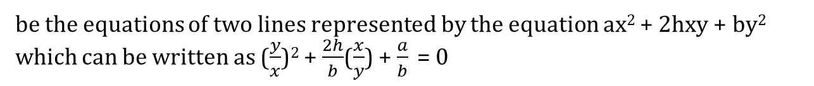
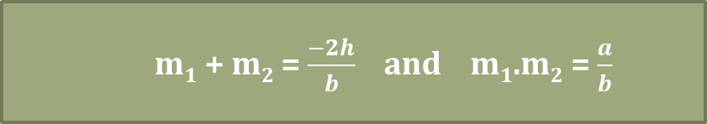
ANGLE BETWEEN THE LINE PAIR REPRESENTED BY
ax² + 2hxy + by² = 0
Let, y = m₁x and y = m₂x
be the equations of two lines represented by the equation ax² + 2hxy + by² which can be written as ($\frac{y}{x}$)² + $\frac{2h}{b}$($\frac{x}{y}$) + $\frac{a}{b}$ = 0
Where,
m₁ + m₂ = $\frac{−2h}{b}$ and m₁.m₂ = $\frac{a}{b}$

Slide 11
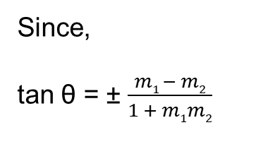

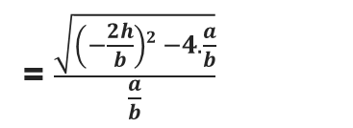

ANGLE BETWEEN THE LINE PAIR
Since,
tan θ = ± $\frac{m1 − m2}{1 + m1m2}$
= $\frac{\sqrt{\left(m1 + m2\right)2 −4m1m2}}{1+m1m2}$
= $\frac{\sqrt{\left(−\frac{2h}{b}\right)2 −4.\frac{a}{b}}}{\frac{a}{b}}$
θ = tan⁻¹($\frac{2\sqrt{h2 −ab}}{a+b}$)
Lines are perpendicular if: a + b = 0
Lines are parallel if: h² = a.b

Slide 12
04
ANGLE BISECTOR BETWEEN THE LINE PAIR

Slide 13
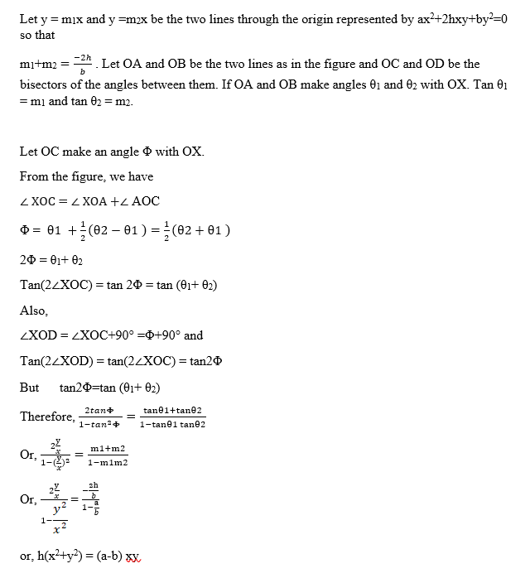
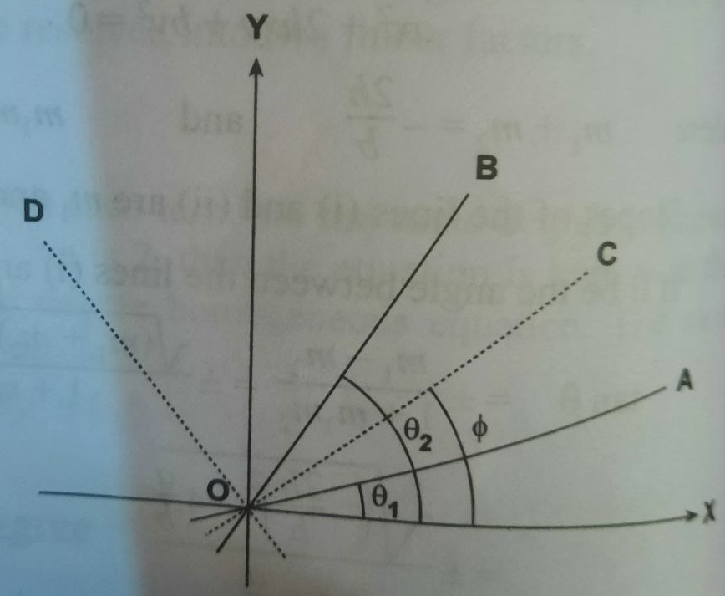
ANGLE BISECTOR BETWEEN THE LINE PAIR REPRESENTED BY
ax² + 2hxy + by² = 0

Slide 14
05
CONDITION THAT THE GENERAL EQUATION OF SECOND DEGREE MAY REPRESENT A LINE PAIR

Slide 15

CONDITION THAT THE GENERAL EQUATION OF SECOND DEGREE MAY REPRESENT A LINE PAIR
The general equation of second degree in x and y is
ax² + 2hxy + by² + 2gx + 2fy + c = 0 (where a ≠ 0)
The equation may be written as:
ax² + 2x(hy + g) + by² +2fy + c = 0
The roots of the equation will be:
x = $\frac{1}{a}${-(hy + g) ± $\sqrt{\left(hy+g\right)2 −a(by2+2fy+c)}$ }
These equations will be linear only if
$\left(hy+g\right)2 −a(by2+2fy+c)$
be a perfect square

Slide 16
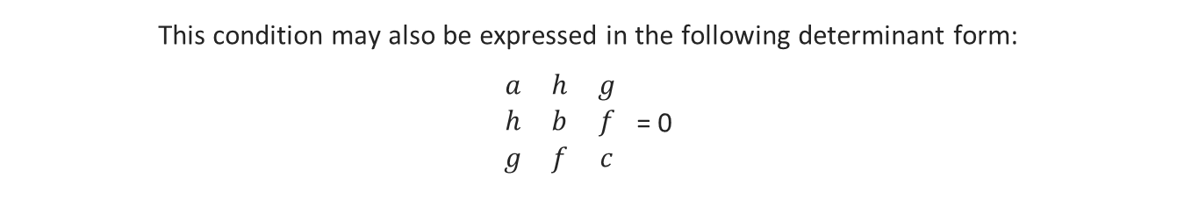
CONDITION THAT THE GENERAL EQUATION OF SECOND DEGREE MAY REPRESENT A LINE PAIR
These equations will be linear only if $\left(hy+g\right)2 −a(by2+2fy+c)$ be a perfect square
Let (h² – ab) y² + 2(gh – af) y + (g² – ac) be a perfect square
(gh – af)² – (h² – ab) (g² – ac) = 0
a (abc + 2fgh – af² – bg² –ch²) = 0
Since a ≠ 0, the required condition is abc + 2fgh – af² – bg² – ch² = 0
This condition may also be expressed in the following determinant form:
$\begin{matrix}a & h & g \\ h & b & f \\ g & f & c\end{matrix}$ = 0

Slide 17
APPLICATIONS OF PAIR OF STRAIGHT LINES

Slide 18
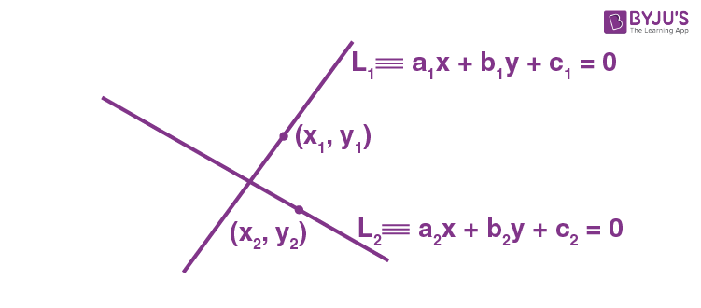
APPLICATIONS OF PAIR OF STRAIGHT LINES
Analytical geometry is widely applied in physics, engineering, computer graphics, and various scientific and technical fields for precise geometric problem-solving.

Slide 19
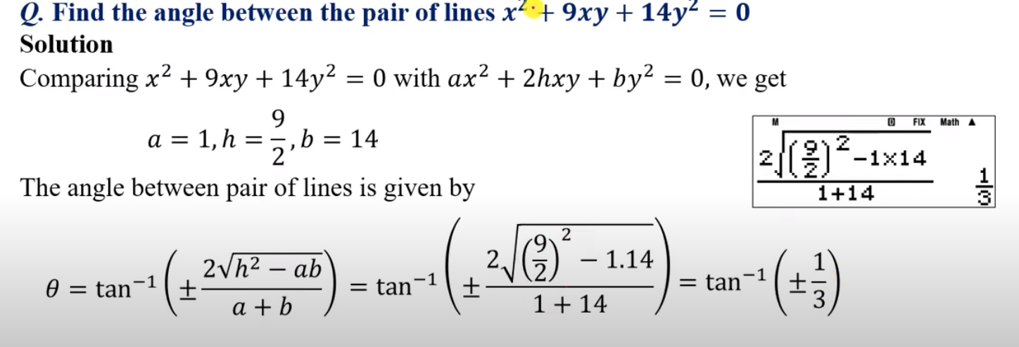
COMPUTATIONAL APPROACH

Slide 20
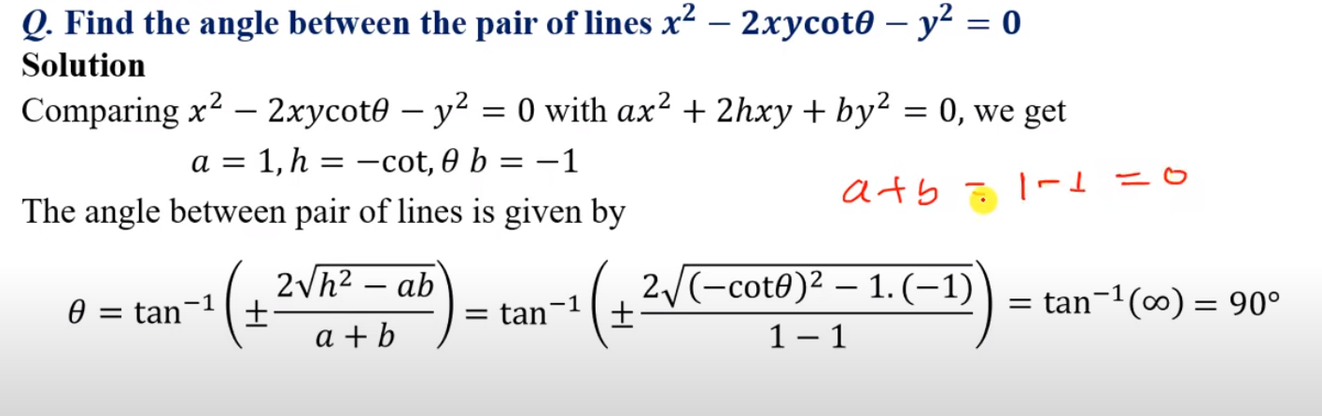
COMPUTATIONAL APPROACH

Slide 21
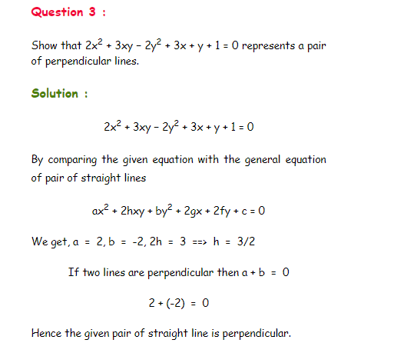

Slide 22
THANK YOU !

